Slide 1
几个证明过程

Slide 2

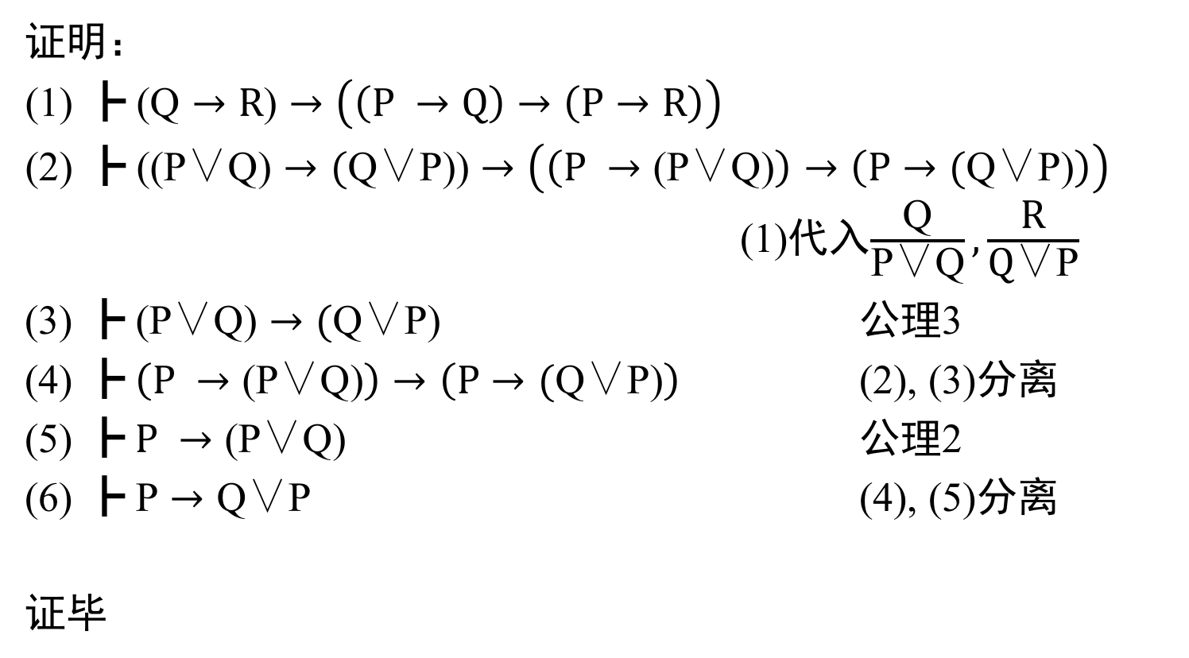
定理1 $\text{┣} \text{P}→\text{Q}\text{∨}\text{P}$
证明：
$\text{┣} \text{(}\text{Q}→R\text{)}→\left(\left(P →Q\right)→\left(P→R\right)\right)$
$\text{┣} \text{(}\text{(}\text{P}\text{∨}\text{Q}\text{)}→\text{(}\text{Q}\text{∨}\text{P}\text{)}\text{)}→\left(\left(P →\text{(}\text{P}\text{∨}\text{Q}\text{)}\right)→\left(P→\text{(}\text{Q}\text{∨}\text{P}\text{)}\right)\right)$ (1)代入$\frac{\text{Q}}{\text{P}\text{∨}\text{Q}},\frac{\text{R}}{\text{Q}\text{∨}\text{P}}$
(3) $\text{┣} \text{(}\text{P}\text{∨}\text{Q}\text{)}→\text{(}\text{Q}\text{∨}\text{P}\text{)}$ 公理3
(4) $\text{┣} \left(P →\text{(}\text{P}\text{∨}\text{Q}\text{)}\right)→\left(P→\text{(}\text{Q}\text{∨}\text{P}\text{)}\right)$ (2), (3)分离
(5) $\text{┣} P →\text{(}\text{P}\text{∨}\text{Q}\text{)}$ 公理2
(6) $\text{┣} \text{P}→\text{Q}\text{∨}\text{P}$ (4), (5)分离
证毕

Slide 3
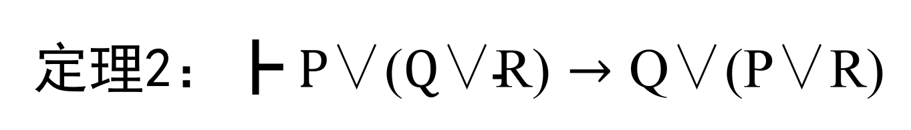
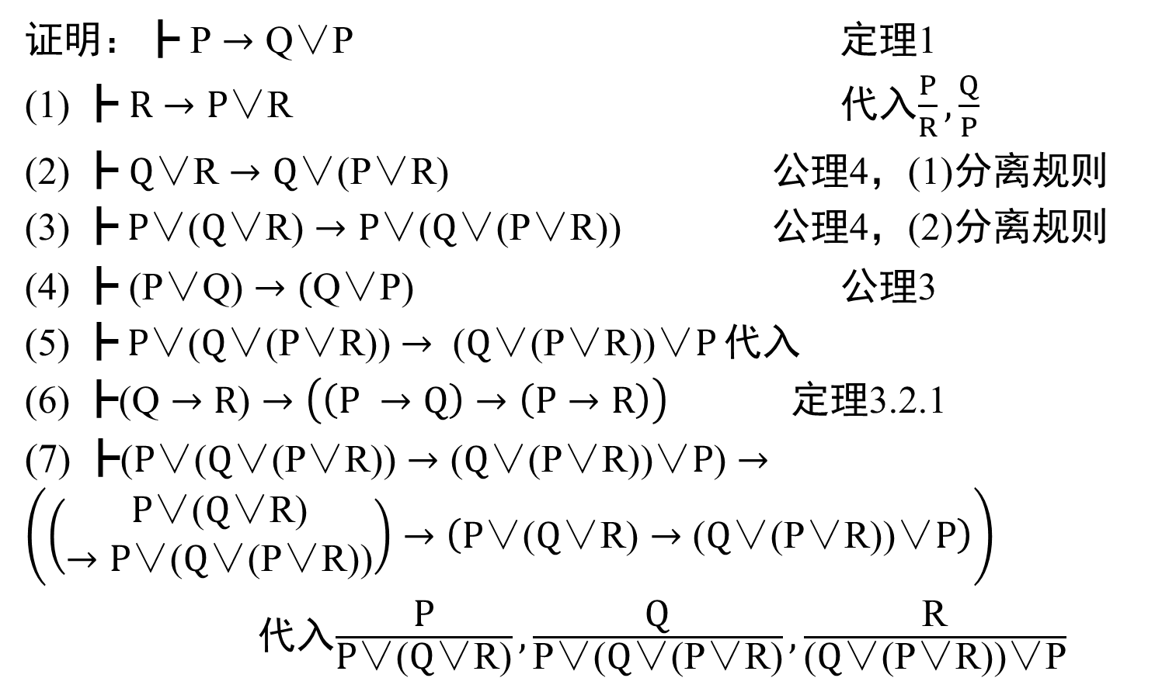
定理2：$\text{┣} P\text{∨(}\text{Q}\text{∨}\text{R}\text{)}→\text{Q}\text{∨(}\text{P}\text{∨}\text{R}\text{) }$
证明：$\text{┣} \text{P}→\text{Q}\text{∨}\text{P}$ 定理1
(1) $\text{┣} R→\text{P}\text{∨}\text{R}$ 代入$\frac{P}{R},\frac{Q}{P}$
(2) $\text{┣} \text{Q}\text{∨}\text{R}→\text{Q}\text{∨}\text{(}\text{P}\text{∨}\text{R}\text{)}$ 公理4，(1)分离规则
(3) $\text{┣} P\text{∨}\text{(}\text{Q}\text{∨}\text{R}\text{)}→P\text{∨(}\text{Q}\text{∨(}\text{P}\text{∨}\text{R}\text{))}$ 公理4，(2)分离规则
(4) $\text{┣} \text{(}\text{P}\text{∨}\text{Q}\text{)}→\text{(}\text{Q}\text{∨}\text{P}\text{) }$ $\text{公理}\text{3}$
(5) $\text{┣} P\text{∨(}\text{Q}\text{∨(}\text{P}\text{∨}\text{R}\text{))}→ \text{(}\text{Q}\text{∨(}\text{P}\text{∨}\text{R}\text{))∨}P$ 代入
(6) $\text{┣}\text{(}\text{Q}→R\text{)}→\left(\left(P →Q\right)→\left(P→R\right)\right)$ 定理3.2.1
(7) $\text{┣}\text{(}P\text{∨(}\text{Q}\text{∨(}\text{P}\text{∨}\text{R}\text{))}→\text{(}\text{Q}\text{∨(}\text{P}\text{∨}\text{R}\text{))∨}P\text{)}→\left(\left(\begin{aligned}P\text{∨(}\text{Q}\text{∨}\text{R}\text{)} \\ →P\text{∨(}\text{Q}\text{∨(}\text{P}\text{∨}\text{R}\text{))}\end{aligned}\right)→\left(P\text{∨(}\text{Q}\text{∨}\text{R}\text{)}→\text{(}\text{Q}\text{∨(}\text{P}\text{∨}\text{R}\text{))∨}P\right)\right)$
代入$\frac{\text{P}}{\text{P}\text{∨(}\text{Q}\text{∨}\text{R}\text{)}},\frac{\text{Q}}{\text{P}\text{∨(}\text{Q}\text{∨(}\text{P}\text{∨}\text{R}\text{)}},\frac{\text{R}}{\text{(}\text{Q}\text{∨(}\text{P}\text{∨}\text{R}\text{))∨}\text{P}}$
P
Q
Q
R

Slide 4
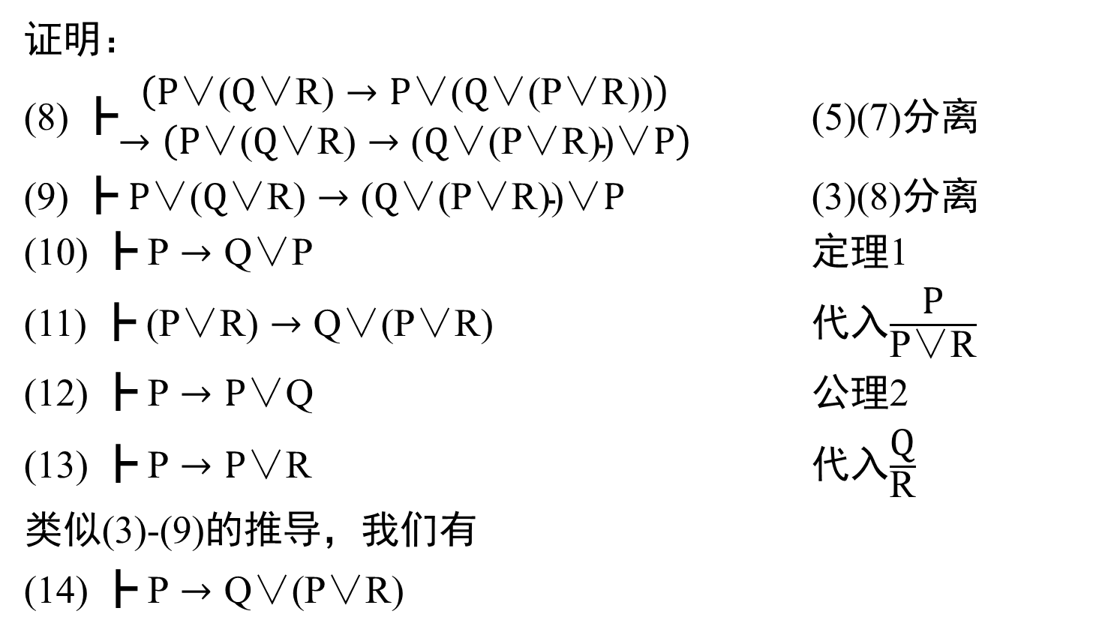
定理2(接上页)
证明：
(8) $\text{┣}\begin{aligned}\left(P\text{∨(}\text{Q}\text{∨}\text{R}\text{)}→P\text{∨(}\text{Q}\text{∨(}\text{P}\text{∨}\text{R}\text{))}\right) \\ →\left(P\text{∨(}\text{Q}\text{∨}\text{R}\text{)}→\text{(}\text{Q}\text{∨(}\text{P}\text{∨}\text{R}\text{))∨}P\right)\end{aligned}$ (5)(7)分离
(9) $\text{┣} P\text{∨(}\text{Q}\text{∨}\text{R}\text{)}→\text{(}\text{Q}\text{∨(}\text{P}\text{∨}\text{R}\text{))∨}P$ (3)(8)分离
(10) $\text{┣} \text{P}→\text{Q}\text{∨}\text{P}$ 定理1
(11) $\text{┣} \text{(}\text{P}\text{∨}\text{R}\text{)}→\text{Q}\text{∨(}\text{P}\text{∨}\text{R}\text{) }$ 代入$\frac{\text{P}}{\text{P}\text{∨}\text{R}}$
(12) $\text{┣} \text{P}→\text{P}\text{∨}\text{Q}$ 公理2
(13) $\text{┣} \text{P}→\text{P}\text{∨}\text{R}$ 代入$\frac{\text{Q}}{\text{R}}$
类似(3)-(9)的推导，我们有
(14) $\text{┣ }\text{P}→\text{Q}\text{∨(}\text{P}\text{∨}\text{R}\text{) }$

Slide 5
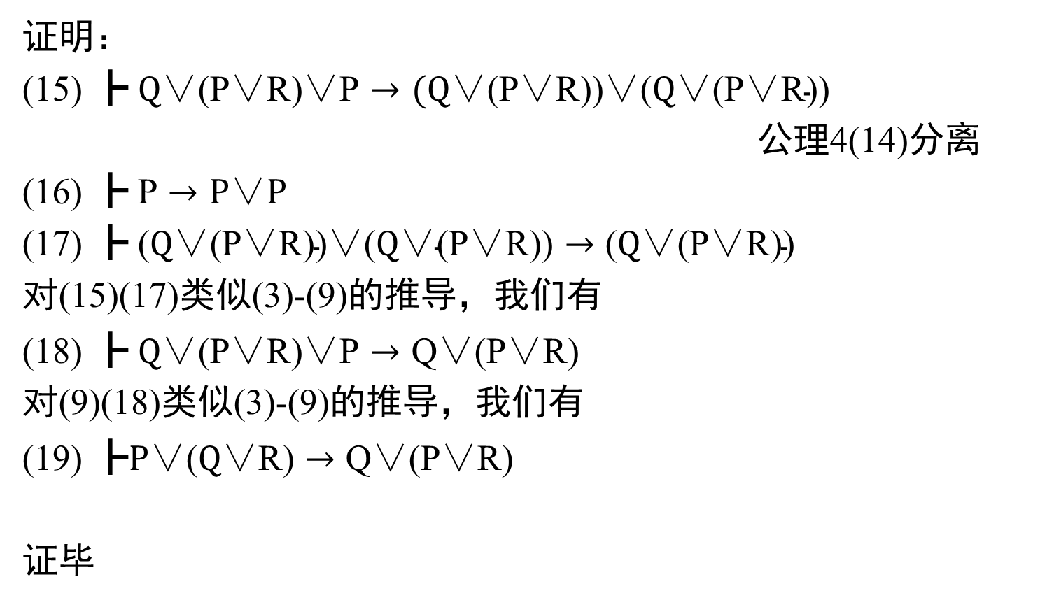
定理2(接上页)
证明：
(15) $\text{┣} \text{Q}\text{∨(}\text{P}\text{∨}\text{R}\text{)∨}\text{P}→\text{(}\text{Q}\text{∨(}\text{P}\text{∨}\text{R}\text{))∨(}\text{Q}\text{∨(}\text{P}\text{∨}\text{R}\text{))}$
公理4(14)分离
(16) $\text{┣} \text{P}→\text{P}\text{∨}P$
(17) $\text{┣}\text{ (}\text{Q}\text{∨(}\text{P}\text{∨}\text{R}\text{))∨(}\text{Q}\text{∨(}\text{P}\text{∨}\text{R}\text{))}→\text{(}\text{Q}\text{∨(}\text{P}\text{∨}\text{R}\text{))}$
对(15)(17)类似(3)-(9)的推导，我们有
(18) $\text{┣} \text{Q}\text{∨(}\text{P}\text{∨}\text{R}\text{)∨}\text{P}→\text{Q}\text{∨(}\text{P}\text{∨}\text{R}\text{) }$
对(9)(18)类似(3)-(9)的推导，我们有
(19) $\text{┣}P\text{∨(}\text{Q}\text{∨}\text{R}\text{)}→\text{Q}\text{∨(}\text{P}\text{∨}\text{R}\text{) }$
证毕

Slide 6
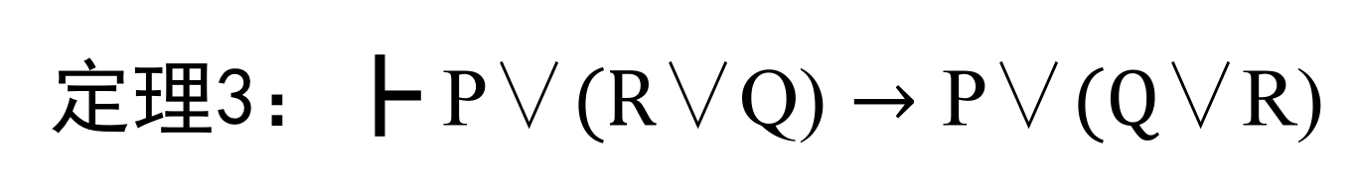
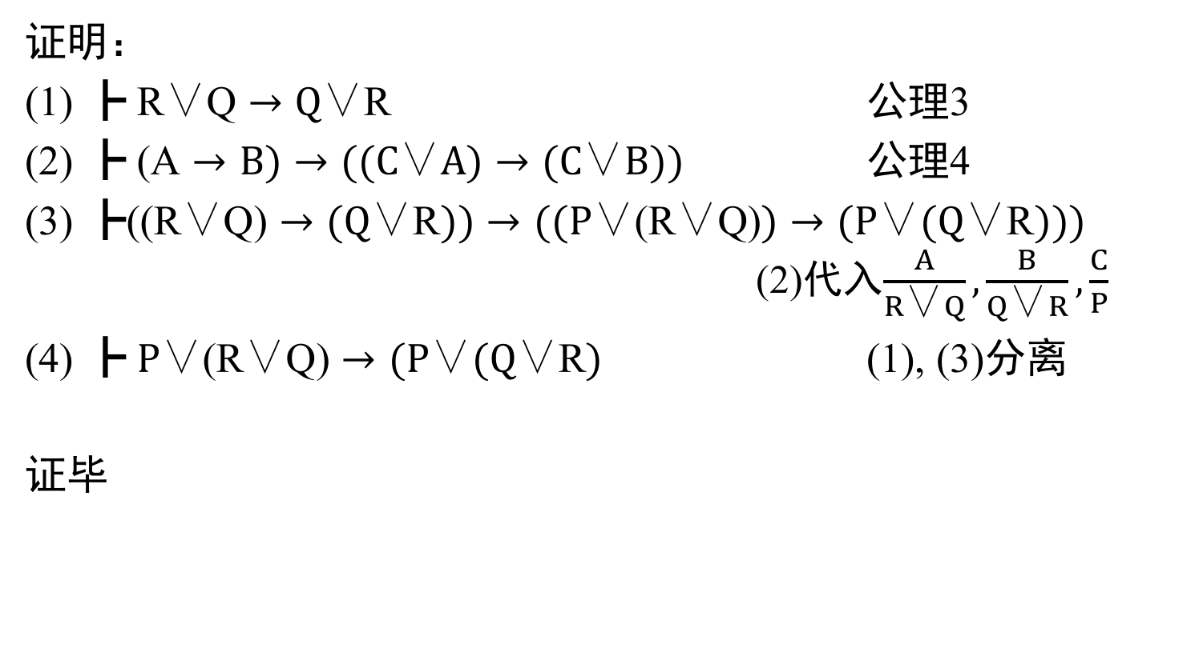
定理3：$\text{┣} \text{P}\text{∨}(R\text{∨}\text{Q}\text{)}→\text{P}\text{∨}(\text{Q}\text{∨}\text{R}\text{)}$
证明：
(1) $\text{┣} \text{R}\text{∨}\text{Q}→\text{Q}\text{∨}\text{R}$ 公理3
(2) $\text{┣} \text{(}\text{A}→\text{B}\text{)}→((\text{C}\text{∨}A)→(\text{C}\text{∨}B))$ 公理4
(3) $\text{┣}\text{(}\text{(}\text{R}\text{∨}\text{Q}\text{)}→\text{(}\text{Q}\text{∨}\text{R}\text{)}\text{)}→((\text{P}\text{∨(}\text{R}\text{∨}\text{Q}\text{)})→(\text{P}\text{∨}\text{(}\text{Q}\text{∨}\text{R}\text{)}))$ (2)代入$\frac{A}{R\text{∨}Q}, \frac{B}{Q\text{∨}R},\frac{C}{P}$
(4) $\text{┣} \text{P}\text{∨(}\text{R}\text{∨}\text{Q}\text{)}→(\text{P}\text{∨}\text{(}\text{Q}\text{∨}\text{R}\text{)}$ (1), (3)分离
证毕

Slide 7

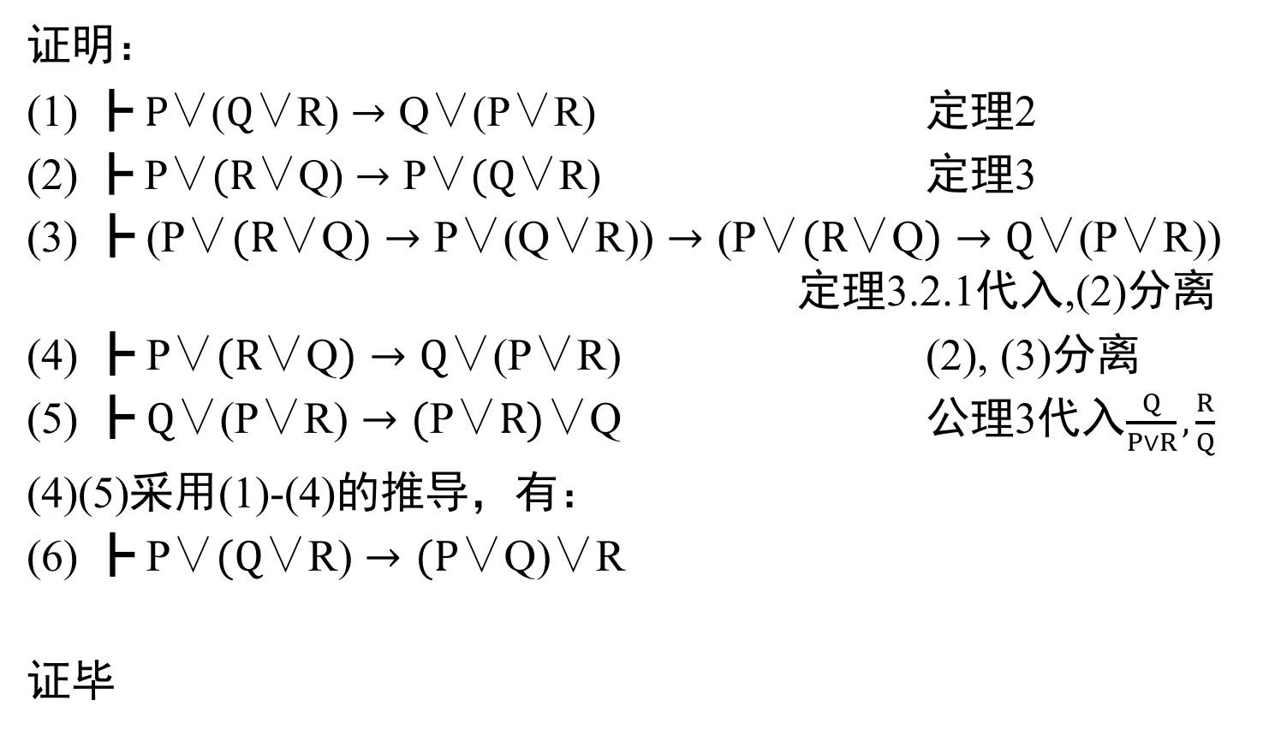
定理4:$\text{┣} \text{P}\text{∨}(Q\text{∨}\text{R}\text{)}→(\text{P}\text{∨}\text{Q}\text{)∨}\text{R}$
证明：
(1) $\text{┣} P\text{∨(}\text{Q}\text{∨}\text{R}\text{)}→\text{Q}\text{∨(}\text{P}\text{∨}\text{R}\text{) }$ 定理2
(2) $\text{┣} \text{P}\text{∨}(R\text{∨}\text{Q}\text{)}→\text{P}\text{∨}(\text{Q}\text{∨}\text{R}\text{)}$ 定理3
(3) $\text{┣} \text{(}\text{P}\text{∨}(R\text{∨}\text{Q})→\text{P}\text{∨(}\text{Q}\text{∨}\text{R}\text{)}\text{)}→\text{(}\text{P}\text{∨}(R\text{∨}\text{Q})→\text{Q}\text{∨(}\text{P}\text{∨}\text{R}\text{))}$ 定理3.2.1代入,(2)分离
(4) $\text{┣} \text{P}\text{∨}(R\text{∨}\text{Q})→\text{Q}\text{∨(}\text{P}\text{∨}\text{R}\text{)}$ (2), (3)分离
(5) $\text{┣} \text{Q}\text{∨(}\text{P}\text{∨}\text{R}\text{)}→\text{(}\text{P}\text{∨}R)\text{∨}\text{Q}$ 公理3代入$\frac{Q}{P∨R},\frac{R}{Q}$
(4)(5)采用(1)-(4)的推导，有：
(6) $\text{┣} \text{P}\text{∨}(Q\text{∨}\text{R}\text{)}→(\text{P}\text{∨}\text{Q}\text{)∨}\text{R}$
证毕
Q
R
P
Q

Slide 8
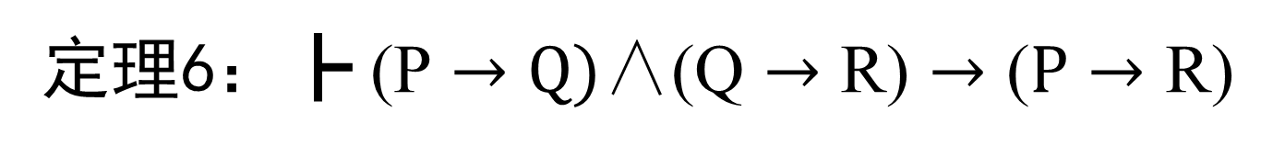
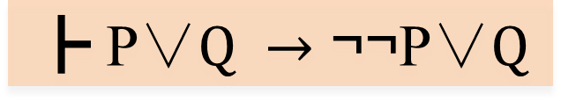
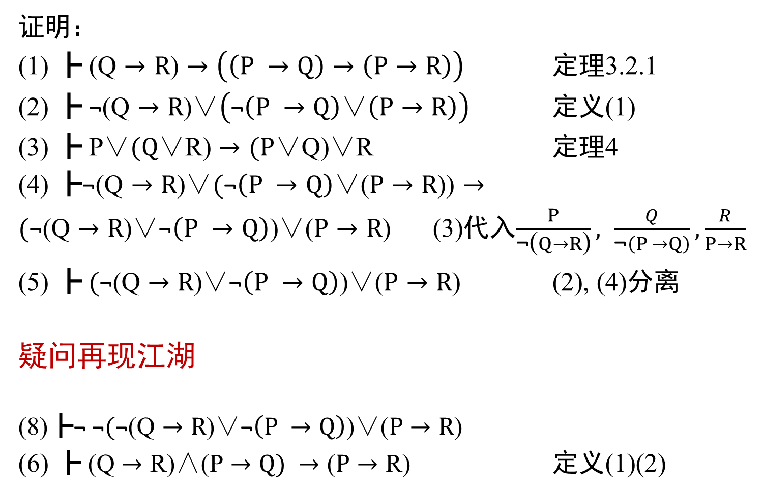
定理6：$\text{┣} \text{(}\text{P}→Q)\text{∧}\text{(}\text{Q}→\text{R}\text{)}→\text{(}P→\text{R}\text{)}$
证明：
(1) $\text{┣} \text{(}\text{Q}→R\text{)}→\left(\left(P →Q\right)→\left(P→R\right)\right)$ 定理3.2.1
(2) $\text{┣} \text{¬}\text{(}\text{Q}→R\text{)∨}\left(\text{¬}\left(P →Q\right)\text{∨}\left(P→R\right)\right)$ 定义(1)
(3) $\text{┣} \text{P}\text{∨}(Q\text{∨}\text{R}\text{)}→(\text{P}\text{∨}\text{Q}\text{)∨}\text{R}$ 定理4
(4) $\text{┣}\text{¬}\text{(}\text{Q}→R\text{)∨}(\text{¬}\left(P →Q\right)\text{∨}\text{(}P→R\text{)}\text{)}→$
$(\text{¬}\text{(}\text{Q}→R\text{)∨}\text{¬}\left(P →Q\right)\text{)∨}\text{(}P→R\text{)}$ (3)代入$\frac{P}{\text{¬}\text{(}Q→R\text{)}}, \frac{Q}{\text{¬}\left(P →Q\right)},\frac{R}{P→R}$
(5) $\text{┣} (\text{¬}\text{(}\text{Q}→R\text{)∨}\text{¬}\left(P →Q\right)\text{)∨(}P→R\text{) }$ (2), (4)分离
疑问再现江湖
(8)$\text{┣}\text{¬} \text{¬}(\text{¬}\text{(}\text{Q}→R\text{)∨}\text{¬}\left(P →Q\right)\text{)∨(}P→R\text{)}$
(6) $\text{┣} \text{(}\text{Q}→\text{R}\text{)}\text{∧}\text{(}\text{P}→Q) →\text{(}P→\text{R}\text{)}$ 定义(1)(2)
$$\text{┣} \text{P}\text{∨}Q →\text{¬¬}\text{P}\text{∨}Q$$

Slide 9
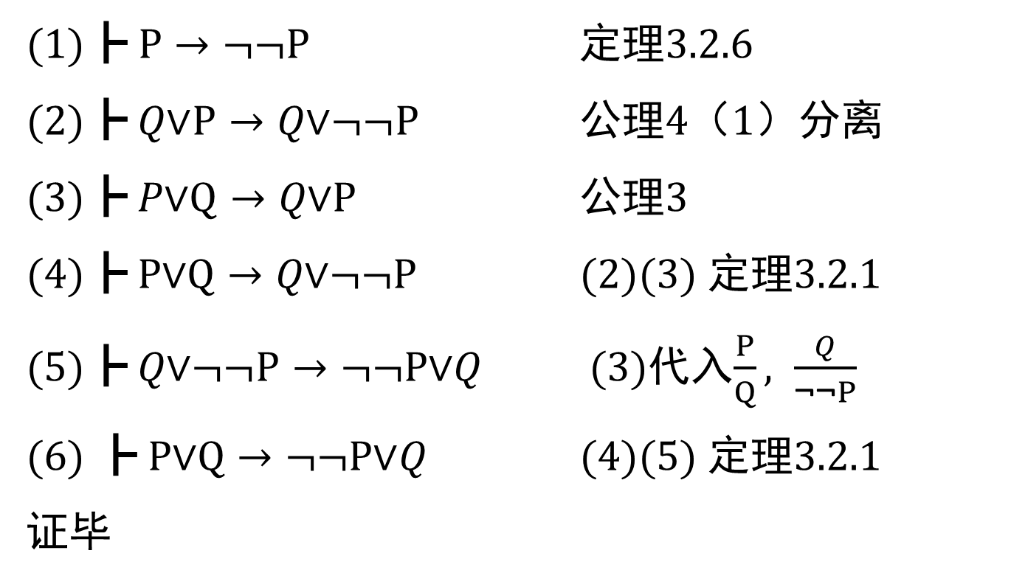

定理5：$\text{┣} \text{P}\text{∨}Q →\text{¬¬}\text{P}\text{∨}Q$
$\text{(1)}\text{┣} \text{P}→\text{¬¬}\text{P}$ 定理3.2.6
$\text{(2)}\text{┣} Q\text{∨}\text{P}→Q\text{∨¬¬}\text{P}$ 公理4（1）分离
$\text{(3)}\text{┣} P\text{∨}\text{Q}→Q\text{∨}\text{P}$ 公理3
(4)$\text{┣} \text{P}\text{∨}\text{Q}→Q\text{∨¬¬}\text{P}$ (2)(3) 定理3.2.1
(5)$\text{┣} Q\text{∨¬¬}\text{P}→\text{¬¬}\text{P}\text{∨}Q$ (3)代入$\frac{P}{Q}, \frac{Q}{\text{¬¬}P}$
(6) $\text{┣} \text{P}\text{∨}\text{Q}→\text{¬¬}\text{P}\text{∨}Q$ (4)(5) 定理3.2.1
证毕

Slide 10
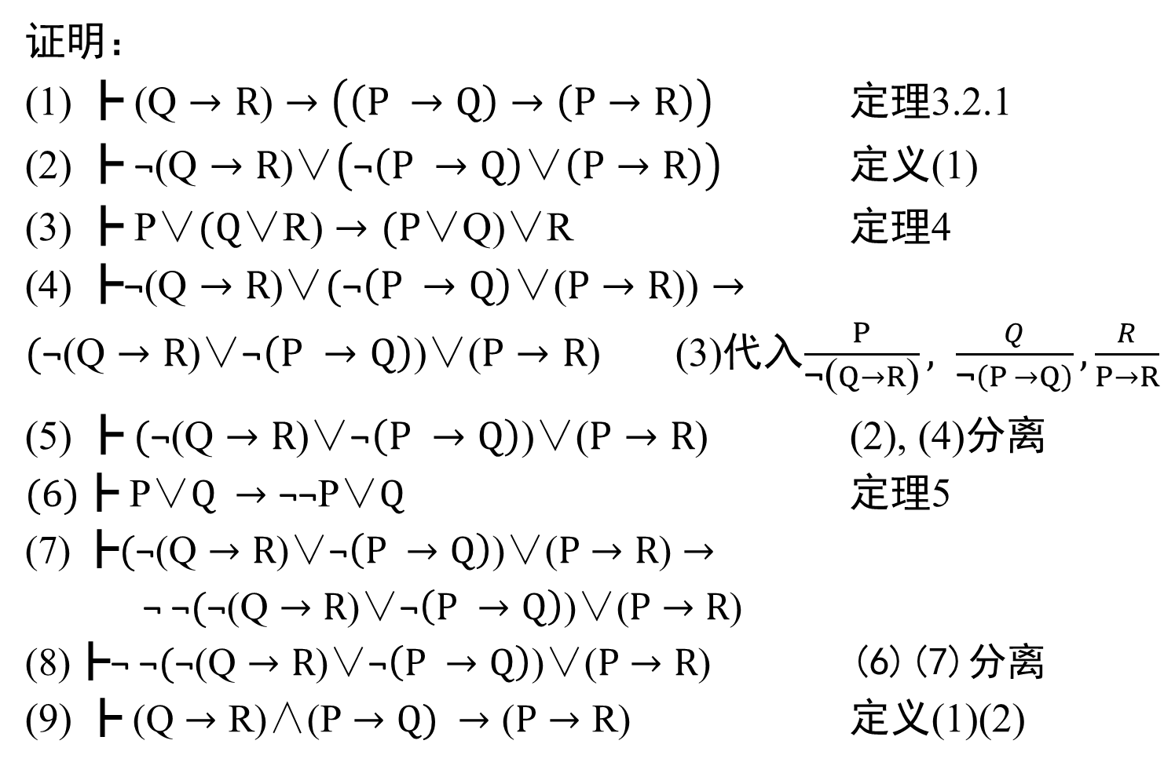
定理6：$\text{┣} \text{(}\text{P}→Q)\text{∧}\text{(}\text{Q}→\text{R}\text{)}→\text{(}P→\text{R}\text{)}$
证明：
(1) $\text{┣} \text{(}\text{Q}→R\text{)}→\left(\left(P →Q\right)→\left(P→R\right)\right)$ 定理3.2.1
(2) $\text{┣} \text{¬}\text{(}\text{Q}→R\text{)∨}\left(\text{¬}\left(P →Q\right)\text{∨}\left(P→R\right)\right)$ 定义(1)
(3) $\text{┣} \text{P}\text{∨}(Q\text{∨}\text{R}\text{)}→(\text{P}\text{∨}\text{Q}\text{)∨}\text{R}$ 定理4
(4) $\text{┣}\text{¬}\text{(}\text{Q}→R\text{)∨}(\text{¬}\left(P →Q\right)\text{∨}\text{(}P→R\text{)}\text{)}→$
$(\text{¬}\text{(}\text{Q}→R\text{)∨}\text{¬}\left(P →Q\right)\text{)∨}\text{(}P→R\text{)}$ (3)代入$\frac{P}{\text{¬}\text{(}Q→R\text{)}}, \frac{Q}{\text{¬}\left(P →Q\right)},\frac{R}{P→R}$
(5) $\text{┣} (\text{¬}\text{(}\text{Q}→R\text{)∨}\text{¬}\left(P →Q\right)\text{)∨(}P→R\text{) }$ (2), (4)分离
$(6)\text{┣} \text{P}\text{∨}Q →\text{¬¬}\text{P}\text{∨}Q$ 定理5
(7)$\text{┣}(\text{¬}\text{(}\text{Q}→R\text{)∨}\text{¬}\left(P →Q\right)\text{)∨(}P→R\text{)}→$
$\text{¬} \text{¬}(\text{¬}\text{(}\text{Q}→R\text{)∨}\text{¬}\left(P →Q\right)\text{)∨(}P→R\text{)}$
(8)$\text{┣}\text{¬} \text{¬}(\text{¬}\text{(}\text{Q}→R\text{)∨}\text{¬}\left(P →Q\right)\text{)∨(}P→R\text{)}$ (6)(7)分离
(9) $\text{┣} \text{(}\text{Q}→\text{R}\text{)}\text{∧}\text{(}\text{P}→Q) →\text{(}P→\text{R}\text{)}$ 定义(1)(2)

Slide 11
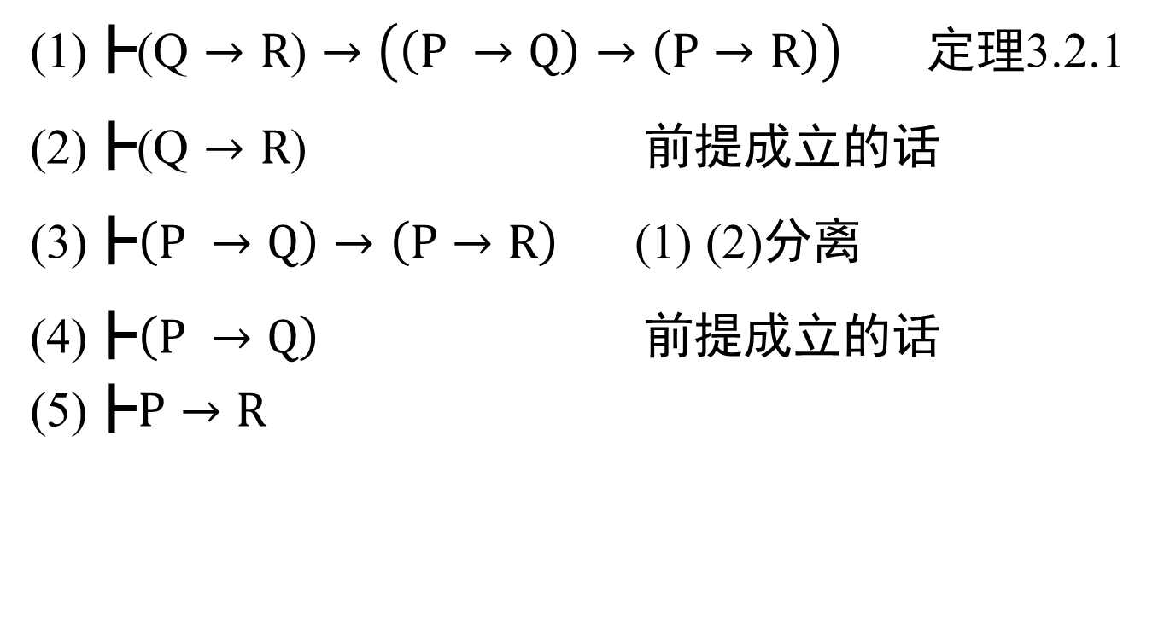
一个更加简便的用三段论的方法
(1)$\text{┣}\text{(}\text{Q}→R\text{)}→\left(\left(P →Q\right)→\left(P→R\right)\right)$ 定理3.2.1
(2)$\text{┣}\text{(}\text{Q}→R\text{)}$ 前提成立的话
(3)$\text{┣}\left(P →Q\right)→\left(P→R\right)$ (1) (2)分离
(4)$\text{┣}\left(P →Q\right)$ 前提成立的话
$$\text{(}\text{5}\text{)}\text{┣}P→R$$

Slide 12
选做题：求更简单的三段论推导方法
悬赏中。。。

Slide 13
